Slide 1
ANALYTICS • SEMANTIC METRICS • GOVERNED AI
MetricMind
Natural-language business analytics over sales and performance data
Project documentation & technical overview
Based on the supplied API code, metrics module and mock_sales.csv
METRICMIND | PROJECT OVERVIEW
1

Slide 2
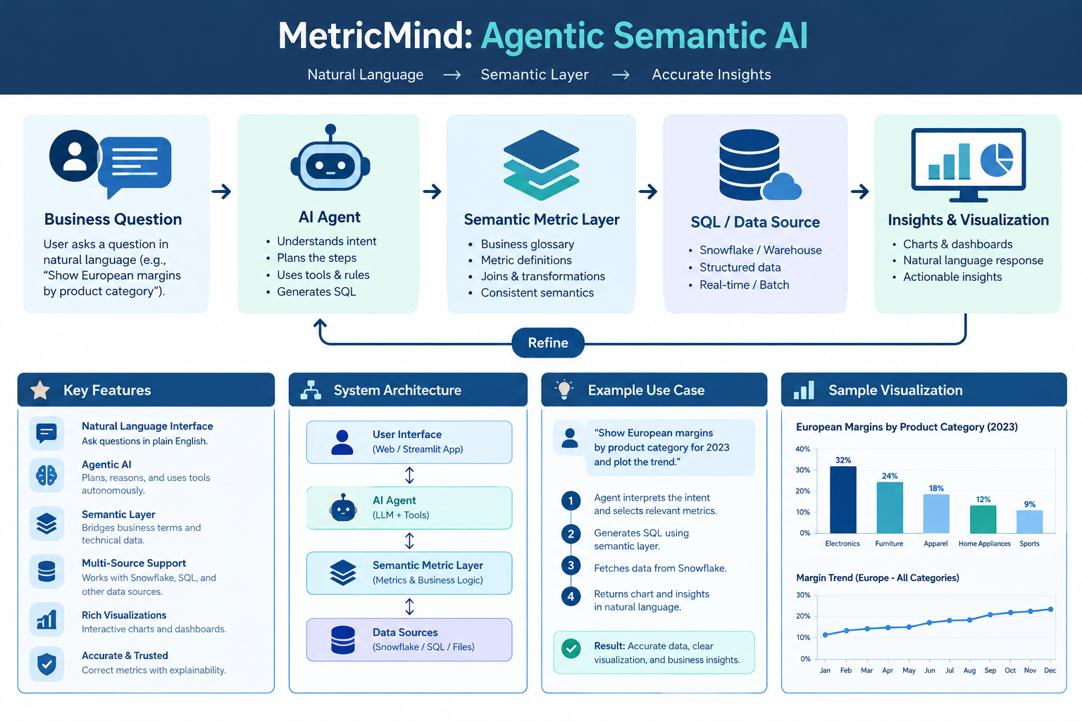

Slide 3
Executive summary
What MetricMind is designed to do
• Translate natural-language business questions into a structured metric request.
• Use a local Ollama model through LangChain to extract intent in JSON.
• Validate metrics, dimensions and operations before building SQL.
• Query PostgreSQL and return results with intent and generated SQL metadata.
• Use a small mock dataset to demonstrate regional and quarterly performance analysis.
ROWS IN MOCK DATA
6
REGIONS
3
QUARTER LABELS
2
METRICMIND | PROJECT OVERVIEW
2

Slide 4
Problem statement
The business problem and intended outcome
Problem
Solution
Business users often ask questions in plain language, while analytics systems expect exact metric names, dimensions and database queries.
MetricMind adds a semantic layer: interpret the question, map it to an approved metric and operation, validate the request, then execute a controlled query.
Example user question
“Why did our European margins drop in Q2?”
METRICMIND | PROJECT OVERVIEW
3

Slide 5
Architecture & request flow
Current code path at a glance
1. User question
2. LangChain + Ollama
3. Governance checks
4. SQL generation
5. PostgreSQL
6. Response
→
→
→
→
→
Natural-language prompt
Extract intent as JSON
Allowlisted metric, dimension, operation
Application builds query
Execute query
Result + intent/SQL metadata
Design principle: the model proposes structured intent; application code validates it and constructs SQL. Do not rely on the LLM alone for database safety.
METRICMIND | PROJECT OVERVIEW
4

Slide 6
Semantic metrics & key-value intent
Controlled vocabulary used to interpret questions
Metric registry
Intent fields / allowlists
• revenue → sales/revenue value
• cost → cost value
• profit → revenue − cost
• profit_margin → profit ÷ revenue × 100
• metric: approved metric identifier
• dimension: country, product or sale_date (in API code)
• operation: total, breakdown, highest or lowest
• filters: validated filter values, where supported
Important: the API vocabulary and CSV schema do not fully match; the CSV uses region and quarter, not country/product/sale_date.
METRICMIND | PROJECT OVERVIEW
5

Slide 7
Mock sales data: snapshot
Descriptive analysis of the supplied CSV
TOTAL REVENUE
TOTAL COST
PROFIT
OVERALL MARGIN
1,110,000
690,000
420,000
37.8%
Dataset fields
region, quarter, revenue, cost, churn_rate
Coverage: 6 records, 3 regions, 2 quarter labels. This is a demonstration dataset, not enough by itself for robust forecasting.
METRICMIND | PROJECT OVERVIEW
6

Slide 8
Visualization 1: revenue by region
Compare total revenue across the mock dataset
How to read it
• Higher bars indicate larger total revenue.
• Pair revenue with cost and margin before judging performance.
• Check the number of observations behind each region.
METRICMIND | PROJECT OVERVIEW
7

Slide 9
Visualization 2: profit margin by region
Profit margin = (revenue − cost) / revenue × 100
Interpretation
• Margin normalizes profit relative to revenue.
• A high-revenue region may still have weaker profitability.
• Use the same formula consistently across groups.
METRICMIND | PROJECT OVERVIEW
8

Slide 10
Visualization 3: quarterly trend
Revenue, cost and margin by quarter
With only two quarter labels, this supports comparison—not reliable seasonality or trend forecasting.
METRICMIND | PROJECT OVERVIEW
9

Slide 11
Scenario: investigate European Q2 margin
A representative business question
Question
What the sample can establish
“Why did our European margins drop in Q2?”
• Compare Europe Q1 and Q2 revenue, cost and margin.
• Check whether cost rose, revenue fell, or both.
• The sample describes the change; it cannot prove causation.
European records
• Q1_2026: revenue 120,000, cost 80,000, margin 33.3%
• Q2_2026: revenue 95,000, cost 75,000, margin 21.1%
For stronger diagnosis, add product mix, price, volume and customer-level drivers.
METRICMIND | PROJECT OVERVIEW
10

Slide 12
Metrics: analytics vs prediction
Choose measures that match the task
Current descriptive analytics
If forecasting is added later
• Revenue, cost and profit totals
• Profit margin percentages
• Regional / quarterly breakdowns
• Highest and lowest groups (if requested)
• MAE: average absolute forecast error
• RMSE: penalizes larger errors
• MAPE: percentage error (careful with zero values)
• Time-based train/test split and baseline comparison
• More historical observations required
The supplied code does not implement a trained prediction model; do not report forecast accuracy without a real held-out evaluation.
METRICMIND | PROJECT OVERVIEW
11

Slide 13
OOP structure & technology choices
Suggested maintainable module boundaries
• API/controller: FastAPI endpoints and request/response models
• Intent parser: LangChain prompt + ChatOllama JSON extraction
• Governance validator: allowlisted metrics, dimensions and operations
• Metric registry: definitions, formulas and descriptions
• Query builder / repository: parameterized SQL and database access
• Analytics service: grouping, calculations and result formatting
Core libraries
• FastAPI — HTTP API
• LangChain — prompt/model orchestration
• Ollama + llama3.2 — local language model
• psycopg2 — PostgreSQL connection
• pandas — CSV and tabular analysis
• matplotlib / python-pptx — reporting visuals
METRICMIND | PROJECT OVERVIEW
12

Slide 14
Governance, reliability & security
Production-readiness checklist
• Use parameterized SQL for all user-provided filter values; never interpolate raw text.
• Keep database credentials in environment variables or a secret manager; rotate any exposed credentials.
• Use a read-only database role and enforce query timeouts and row limits.
• Validate LLM output against a strict schema; reject unknown metric, dimension or operation values.
• Log request IDs, validated intent, execution time and errors—avoid logging secrets or sensitive rows.
• Add tests for malformed JSON, unsupported requests, zero revenue, empty data and database failures.
The uploaded code includes governance concepts; verify SQL safety and credential handling before production deployment.
METRICMIND | PROJECT OVERVIEW
13

Slide 15
Limitations & next steps
What is needed to move from demo to dependable analytics
Known limitations
Recommended roadmap
• Small sample dataset: six rows.
• Schema mismatch: API uses country/product/sale_date; CSV uses region/quarter.
• Referenced agent/governance modules were not included in the supplied files.
• No trained prediction model or forecast evaluation is present.
• Align database schema, metric registry and CSV field names.
• Add automated tests and typed request/response schemas.
• Build a curated scenario and question test set.
• Add forecast model only when sufficient dated history exists.
• Monitor query validity, latency and answer correctness.
METRICMIND | PROJECT OVERVIEW
14

Slide 16
KEY TAKEAWAYS
Make business questions measurable, validated and explainable.
• Semantic metrics reduce ambiguity between business language and data fields.
• LangChain + Ollama can extract intent; governance and application code must enforce constraints.
• Charts help reveal differences, but small mock data supports descriptive analysis only.
• Prediction requires a separate modeling pipeline and honest evaluation metrics.
End of presentation • MetricMind
METRICMIND | PROJECT OVERVIEW
15

Slide 17
What We Gain from Data Science Research
Research outcomes from technical, documentation and statistical perspectives
TECHNICAL VALUE
DOCUMENTATION VALUE
STATISTICAL VALUE
• Natural-language questions mapped to structured intent
• Governed metrics and safer query flow
• Reusable API and modular OOP design
• Clear problem statement and architecture
• Reproducible methods, formulas and assumptions
• Traceable limitations, tests and next steps
• Descriptive summaries and comparisons
• Revenue, cost, profit and margin calculations
• Charts to identify patterns for investigation
MAIN RESEARCH CONCLUSION
Combine domain questions, validated metrics, transparent calculations and visual evidence to make analysis understandable and repeatable.
EVIDENCE LIMIT
The six-row mock dataset supports demonstration-level descriptive analysis—not strong causal claims or reliable forecasting.
METRICMIND | PROJECT OVERVIEW
16

Slide 18
Potential Focus: Government & Marine Affairs
A future domain application—not a result established by the current mock sales dataset
POTENTIAL DATA SCIENCE USE CASES
DATA & GOVERNANCE REQUIREMENTS
• Monitor coastal and marine indicators over time
• Compare regions, seasons and monitoring stations
• Analyze fisheries, water quality or coastal-risk indicators when reliable data is available
• Generate plain-language reports for public-sector analysts
• Flag unusual changes for expert review—not automatic policy decisions
• Use authoritative government or scientific datasets and record source/date
• Define each indicator, unit, geographic scope and update frequency
• Validate missing values, measurement methods and sensor quality
• Protect sensitive location or operational information
• Document uncertainty, model limits and human review
RECOMMENDED NEXT STEP
Obtain a marine-affairs dataset and align its actual fields with the metric registry before making domain-specific claims.
METRICMIND | PROJECT OVERVIEW
17

